Slide 1
Lab 8 (Laravel Migration and Database Designing)
CSE 3100 : Web Programming
Subah Nawar
Lecturer,
Dept of CSE, KUET
Email: nawar@cse.kuet.ac.bd
Kazi Saeed Alam
Assistant Professor,
Dept of CSE, KUET
Email: saeed.alam@cse.kuet.ac.bd

Slide 2
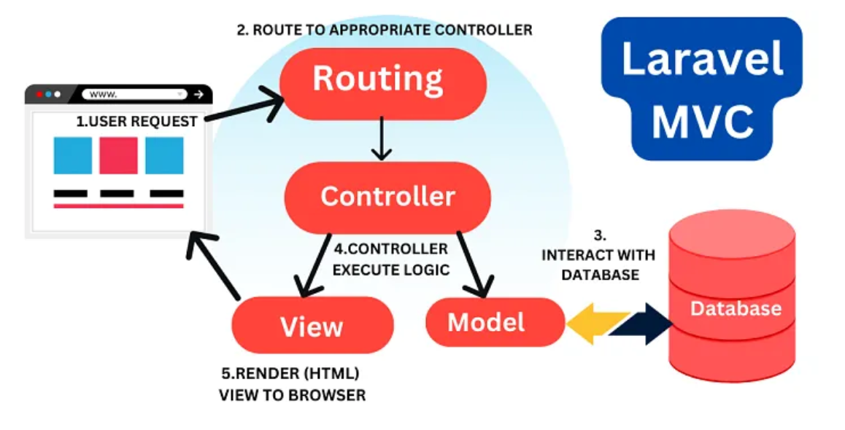

Slide 3
Database: Migrations
Laravel migrations provide a version control system for your database schema, allowing you to define and modify your database structure using PHP code instead of raw SQL.
This simplifies database management, especially in collaborative environments and across different deployment stages.

Slide 4
Eloquent ORM
Laravel includes Eloquent, an object-relational mapper (ORM) that makes it enjoyable to interact with your database.
When using Eloquent, each database table has a corresponding "Model" that is used to interact with that table.
Eloquent models allow you to read,insert, update, and delete records from the table.

Slide 5
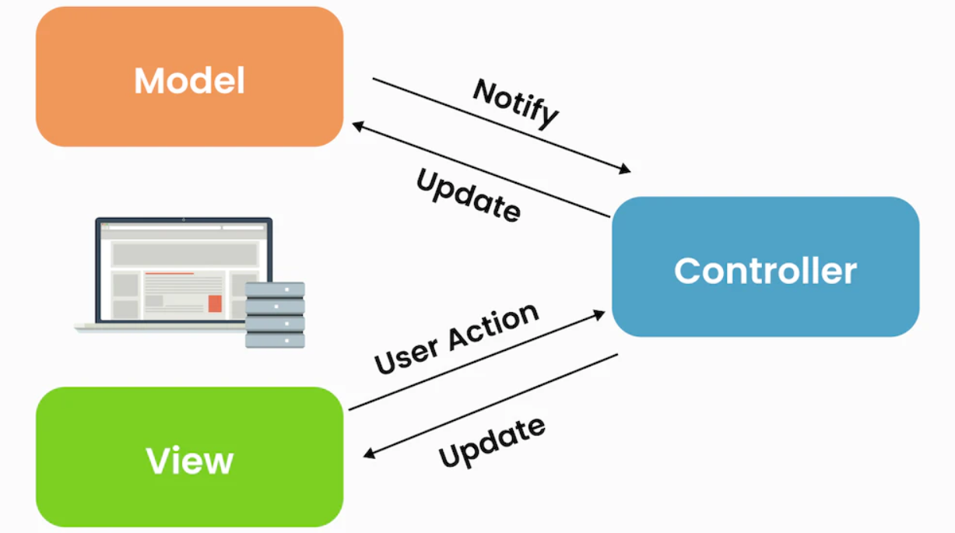
Laravel Controller
Controller are class based php files.
Controllers can group related request handling logic into a single class.
Brings OOP functionalities.
Types of Controller:
1. Basic Controllers
2. Single Action Controllers
3. Resource Controllers (CRUD)

Slide 6
Controller Commands
Basic Controller:
php artisan make:controller ControllerName
DemoController.php
<?php
namespace App\Http\Controllers;
use Illuminate\Http\Request;
class DemoController extends Controller
{
public function index(){
return view('home');
}
}
web.php
<?php
use Illuminate\Support\Facades\Route;
use App\Http\Controllers\DemoController;
Route::get('/', [DemoController::class, 'index']);

Slide 7
Controller Commands
Single Action Controller:
php artisan make:controller ControllerName –invokable
Resource Controller:
php artisan make:controller ControllerName –resource

Slide 8
References
https://www.javatpoint.com/laravel
https://www.tutorialspoint.com/laravel
https://www.wscubetech.com/

Slide 9
Thank You!!!

